Slide 1
INFOSYS SPRINGBOARD VIRTUAL INTERNSHIP 7.0 | MILESTONE 4
Cyber Threat Analytics Platform with Incident Visualization System
Understanding how data analytics and visualization help identify, monitor, and respond to cybersecurity threats.
Prepared by: Akshay Jaiswal
Data Visualization Intern • Infosys Springboard

Slide 2
Objective
1
Build a Clean, Analysis-Ready Dataset
Transform raw cybersecurity network logs into a structured table using Power Query in Power BI.
2
Engineer Risk Indicators
Derive fields such as Severity Score, Urgency Flag and Incident ID to support faster triage of events.
3
Enable Real-Time Threat Visualization
Use the structured data to power an interactive Power BI dashboard for monitoring and investigating threats.

Slide 3
Introduction
What is Advanced Threat Incident Analytics?
The process of collecting, analyzing and interpreting cybersecurity data to detect, investigate and respond to security threats in real time.
It focuses on:
• Detecting cyber attacks early
• Identifying suspicious user or network behaviour
• Reducing incident response time
• Supporting informed, data-driven security decisions
About ThreatLens
ThreatLens works with a simulated network-log dataset, preparing it in Power BI's Power Query editor and building it into an interactive security visualization dashboard.
Typical Data Sources
 Network Logs
 Firewall Logs
 User Login Activity
 Endpoint Devices
 Cloud Applications
 SIEM Systems

Slide 4
END-TO-END POWER QUERY PROCESS, FROM RAW LOGS TO A LOAD-READY ANALYTICAL TABLE
Workflow (Pre processing)
01 
Load Data
Connect to raw log source
02 
Remove Duplicates & Blanks
De-duplicate log entries
03 
Fix Data Types
Correct date, time & numeric types
04 
Trim & Clean Text
Standardise protocol & text fields
05 
Engineer Risk Fields
Severity score & urgency flag
06 
Generate Incident ID
Unique identifier per event
07 
Drop Noisy Columns
Remove high-cardinality fields
08 
Close & Load
Load into the Power BI data model

Slide 5
PLANNED WORKFLOW AFTER THE DATA IS CONNECTED AND LOADED INTO POWER BI
Workflow Diagram
01
Problem Understanding
Define objectives & metrics
02
Data Ingestion
Establish source connection
03
Data Preprocessing
Applied steps in Power Query
04
Build Data Model
Set up table relationships
05
Define KPIs & DAX
Incident counts & ratios
06
Design Visuals
Select chart visual styles
07
Build Dashboard
Assemble visuals in layout
08
Add Interactivity
Slicers & drill-throughs
09
Test & Validate
Check data alignment
10
Publish & Share
Publish to Power BI Cloud
* Green borders represent Milestone 1 (Foundation stage). Blue borders represent Milestone 2 & 3 (Modeling & Dashboard visualization stages).

Slide 6
Problem Understanding
Security teams generate massive volumes of raw log data every day across firewalls, endpoints and network devices. In its raw form, this data is inconsistent — mixed data types, duplicate entries, unstructured timestamps and noisy, high-cardinality fields — making it difficult for analysts to quickly judge how severe or urgent an event is.

What's needed

Data Standardization
A repeatable Power Query pipeline that cleans and standardises raw traffic logs.

Derived Risk Indicators
Derived risk fields (severity, urgency) so analysts can triage without manual review.

Dashboard Readiness
A structured table ready to feed dashboards, KPIs and trend visualizations.

Slide 7
Data Collection and Understanding
cybersecurity_threat_detection_logs
Power BI query / table name
A simulated network-traffic log capturing connection attempts across internal and external IP ranges, each labelled allowed or blocked across common protocols (TCP, UDP, HTTP, HTTPS, FTP, SSH, ICMP).
Raw fields captured at source:
• timestamp (date & time of the event)
• source_ip & dest_ip (connection endpoints)
• protocol & action (network protocol & firewall choice (allowed/blocked))
• user_agent & request_path (high-cardinality metadata (later dropped))
6 Million
rows previewed in Power Query
13
final columns after cleaning
7
protocol types observed

Slide 8
COLUMN-LEVEL UNDERSTANDING OF THE FINAL STRUCTURED TABLE
Data Collection and Understanding
Column | Type | Description
Date | Date | Calendar date of the network event, split out from the raw timestamp
Time | Time | Time of day the connection attempt occurred
source_ip | Text | Originating IP address of the connection attempt
dest_ip | Text | Destination / internal IP address that was contacted
protocol | Text (categorical) | Network protocol used — TCP, UDP, HTTP, HTTPS, FTP, SSH or ICMP
action | Text (categorical) | Firewall decision recorded for the event — allowed or blocked
Severity_score | Whole number | Conditional column scoring the risk level of the event
Urgency_Flag | Flag / text | Derived flag marking events that need immediate analyst review
IP_Network_Origin | Text | Subnet portion extracted from source_ip, used to group traffic by origin
Incident_ID | Text | Unique identifier generated for every logged event
+ 3 supporting fields retained after the transformation (e.g. protocol grouping / reordering helpers) — total 13 columns.

Slide 9
Data Connection
Connecting the Source in Power BI
The raw cybersecurity_threat_detection_logs file was connected to Power BI as a new data source, opening it directly in the Power Query editor.
The first row of the raw file — containing the actual field names — was promoted to become proper column headers.
Power Query then auto-detected an initial data type for every column, based on a sample of the values, as a starting point before further correction.
—
This connection step is the entry point of the pipeline — everything from here (preprocessing, modeling, visualization) builds on top of this initial load.
Connection Summary
SOURCE
cybersecurity_threat_detection_logs
TOOL
Power BI - Power Query Editor
ROWS CONNECTED
999+

Slide 10
21 APPLIED STEPS IN THE POWER QUERY EDITOR, GROUPED INTO 10 TRANSFORMATION STAGES
Data Preprocessing
1. Source
Connect to the raw network-log data
6. Trim & Standardise Text
Trimmed metadata; cleaned protocol groupings; reordered columns
2. Promote Headers & Set Types
Promoted headers; changed column & datatypes
7. Engineer Risk Fields
Added Severity_score (conditional) & Urgency_Flag
3. Filter Date Range
Filtered the dataset to the relevant date window
8. Extract IP Origin
Duplicated column; extracted subnet; renamed to IP_Network_Origin
4. Remove Duplicates
Removed duplicate log entries
9. Generate Incident ID
Generated & renamed a unique Incident_ID per row
5. Format Timestamp
Formatted timestamp; inserted separate Date & Time columns
10. Drop High-Cardinality Columns
Removed user_agent, request_path & raw timestamp

Slide 11
KEY CLEANING TECHNIQUES APPLIED DURING PREPROCESSING
Data Preprocessing

Removing Duplicates
Eliminated repeated log entries so every incident is represented exactly once in the model.

Fixing Data Types
Converted date, time and numeric fields to their correct types for accurate filtering, sorting and aggregation.

Text Standardisation
Trimmed technical metadata and whitespace; grouped inconsistent protocol labels into clean categories.

Handling High-Cardinality Noise
Dropped free-text columns (user_agent, request_path, raw timestamp) that added noise without analytical value.

Feature Engineering
Created Severity_score, Urgency_Flag, IP_Network_Origin and Incident_ID to enable risk-based analysis downstream.

Slide 12
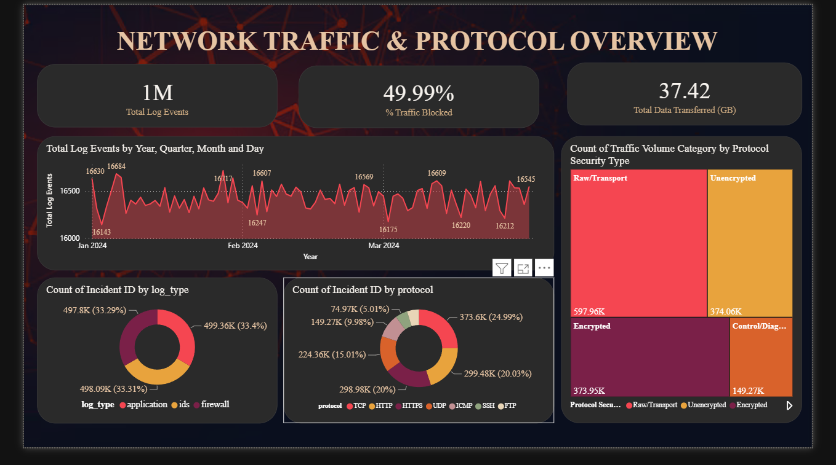
PAGE 1 OF THE POWER BI REPORT: 1,495,242 NETWORK LOG EVENTS, JAN–MAR 2024
Dashboard — Network Traffic & Protocol Overview
Key Visuals & Findings
• KPI cards: Total Log Events, % Traffic Blocked, and Total Data Transferred set the scale for the page: ~1.5 million events, close to half blocked, and the total data volume moved during the quarter.
• Daily Traffic Trend: tracks daily event volume from January to March, split by allowed vs. blocked. The steady, consistent pattern shows the network was under normal load, with no major spikes or incidents.
• Traffic by Protocol: breaks total traffic down across the seven protocols in the dataset. TCP and the web protocols dominate, which is expected for a typical enterprise network.
• Log Volume by Log Type & Action: compares application, IDS, and firewall logs by how much traffic each allowed vs. blocked, acting as a quick check on whether defenses are behaving.
• Traffic Volume Category by Protocol Security Type: uses two engineered columns (security grouping & volume quartiles) to show whether heavy traffic moves over encrypted or unencrypted channels.

Slide 13
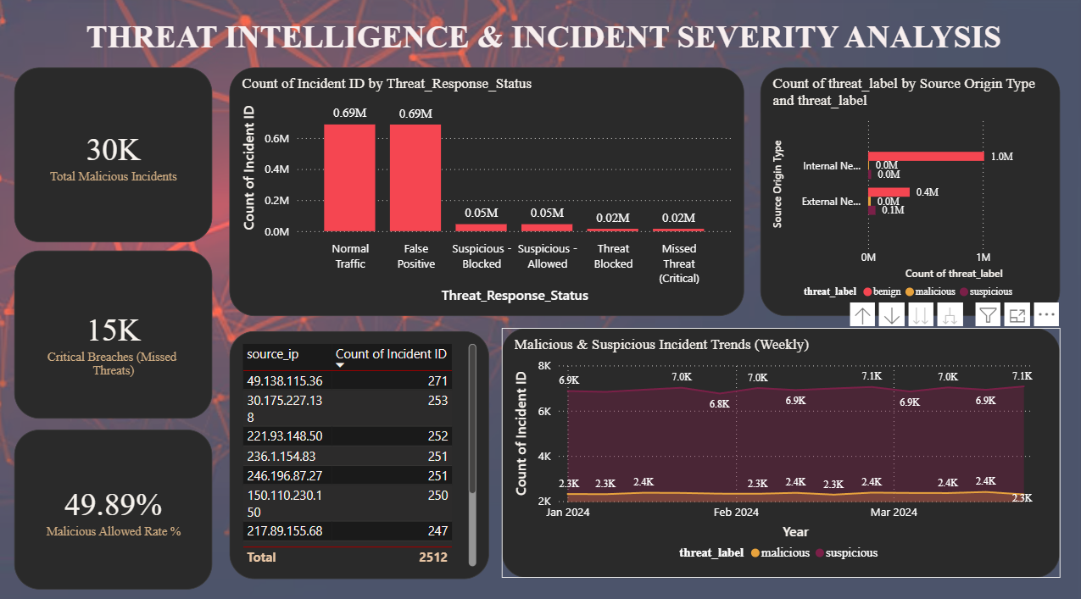
PAGE 2 OF THE POWER BI REPORT: WHAT WAS DANGEROUS, AND DID WE CATCH IT?
Dashboard — Threat Intelligence & Incident Severity
Key Visuals & Findings
• KPI cards: Total Malicious Incidents, Critical Breaches (Missed Threats), and Malicious Allowed Rate % show that ~30,000 events were malicious, and nearly half of those (49.89%) were still marked 'allowed' — the key number on this dashboard.
• Incident Count by Threat Response Status: a custom status column combining threat label and action into readable categories like Missed Threat, Threat Blocked, and False Positive, with Missed Threats highlighted in red as the biggest concern.
• threat_label by Source Origin Type: splits traffic into internal vs. external origin to show whether threats are mostly coming from outside attackers or from within the network.
• Top 10 Source IPs by Malicious Incident Count: a ranked table of the riskiest source IPs, meant as a direct starting point for investigation.
• Weekly Trend of Malicious & Suspicious Incidents: tracks threat activity by week (instead of by day, since the time field lacked hourly detail) to show whether threats are rising, falling, or flat across the quarter.

Slide 14
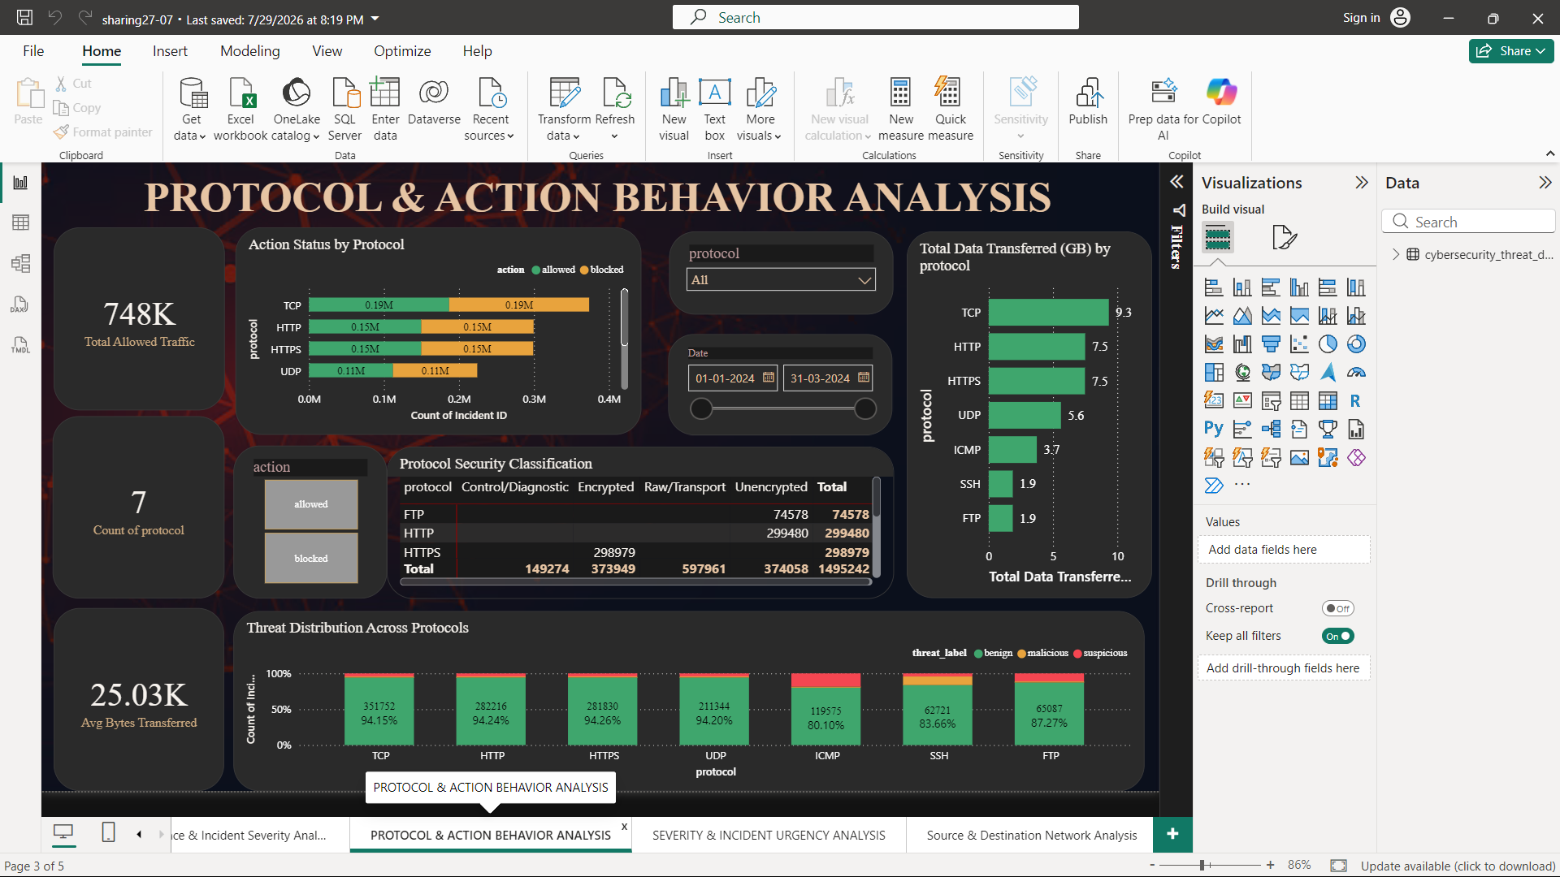
PAGE 3 OF THE POWER BI REPORT: HOW TRAFFIC SPLITS AND BEHAVES ACROSS DIFFERENT PROTOCOLS
Dashboard — Protocol & Action Behavior Analysis
Key Visuals & Findings
• KPI cards: Total Allowed Traffic (748K), Distinct Protocols count (7), and Average Bytes Transferred (25.03K).
• Action Status by Protocol: A stacked bar chart comparing how much traffic was allowed vs. blocked on each protocol. Highlights block rates on UDP/ICMP vs. standard TCP web traffic.
• Total Data Transferred (GB): A horizontal bar chart displaying byte sum conversions into Gigabytes. TCP (9.3 GB) dominates, followed closely by HTTP and HTTPS (7.5 GB each).
• Protocol Security Matrix: Cross-tabulates protocols against calculated security classifications to identify unencrypted protocol volume (HTTP/FTP at 374K events).
• Threat Distribution: A 100% stacked column chart detailing threat label percentages (benign, suspicious, malicious) per protocol. Highlights ICMP as having the highest suspicious footprint (20%).

Slide 15
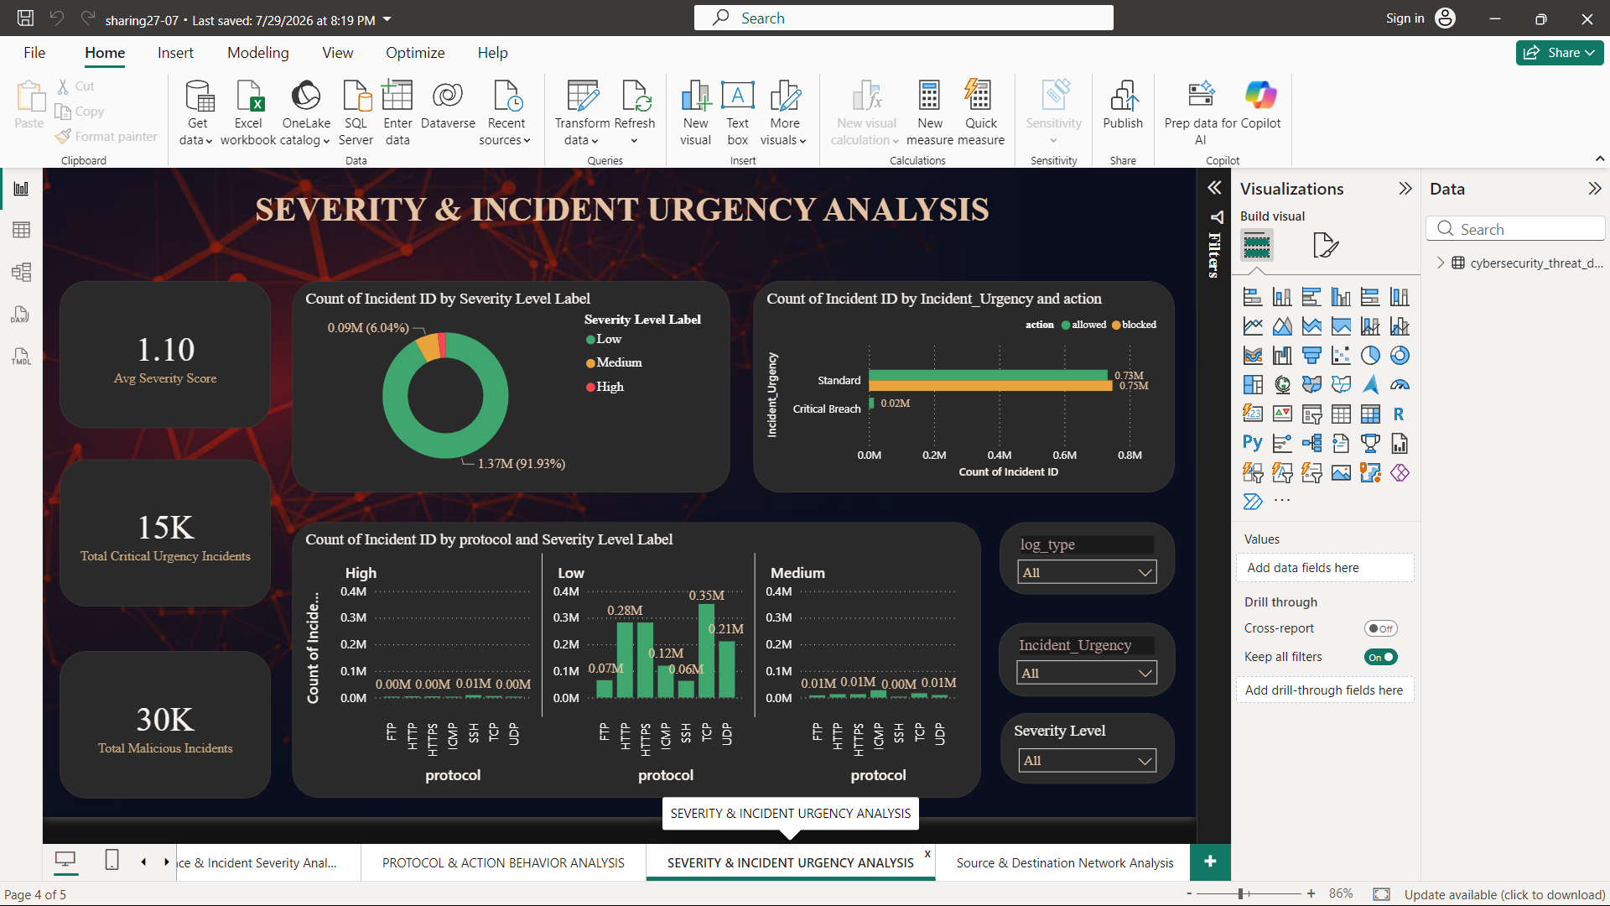
PAGE 4 OF THE POWER BI REPORT: ISOLATING CRITICAL EVENTS BASED ON THREAT SEVERITY WEIGHTS
Dashboard — Severity & Incident Urgency Analysis
Key Visuals & Findings
• KPI cards: Average Severity Score (1.10), Total Critical Urgency Incidents (15K allowed missed threats), and Total Malicious Incidents (30K).
• Severity Level Label: A donut chart summarizing events. 91.93% (1.37M) are Low-severity, while ~8% represent Medium and High severity incidents requiring quick SOC analysis.
• Incident Urgency vs Action: A clustered bar chart grouping events into 'Standard' and 'Critical Breach'. Directly isolates the 15,000 allowed High-Severity malicious breaches.
• Severity Distribution: A trellis column chart displaying connection counts by protocol, grouped under High, Low, and Medium severity panels to map vulnerability trends.

Slide 16
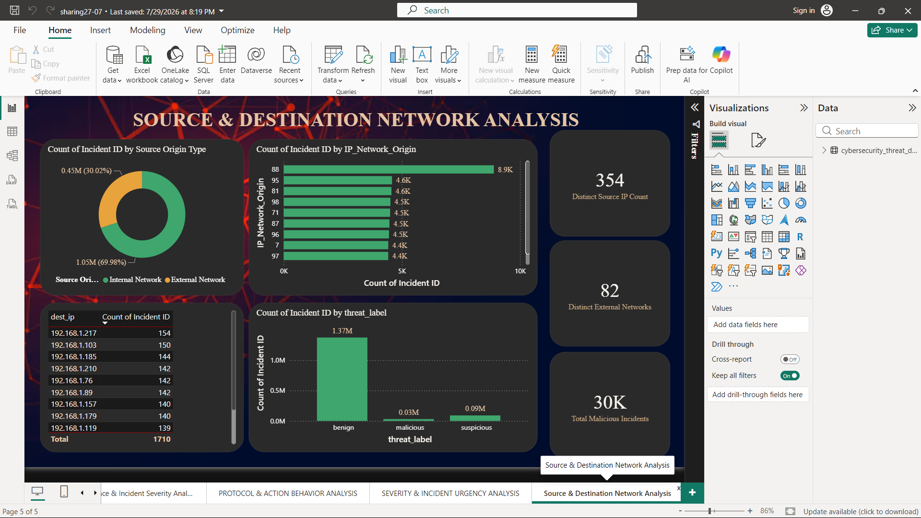
PAGE 5 OF THE POWER BI REPORT: MAPPING BOUNDARY DISTRIBUTIONS AND NETWORK FLOW VECTORS
Dashboard — Source & Destination Network Analysis
Key Visuals & Findings
• KPI cards: Distinct Source IP Count (354), Unique External Networks (82), and Total Malicious Incidents (30K).
• Source Origin Type: A donut chart mapping boundaries. Shows 69.98% of connections are internal corporate communications, while 30.02% represent external traffic.
• IP Network Origin: A bar chart identifying subnets generating the highest traffic loads. Subnet `192` dominates, followed by subnets `88` and `95`.
• Destination Target IP Table: A table ranking target internal destination IPs. Identifies target internal assets under communication or threat (led by `192.168.1.217` with 154 events).
• Threat Labels: A vertical bar chart profiling network threat ratios (1.37M Benign, 90K Suspicious, and 30K Malicious).

Slide 17
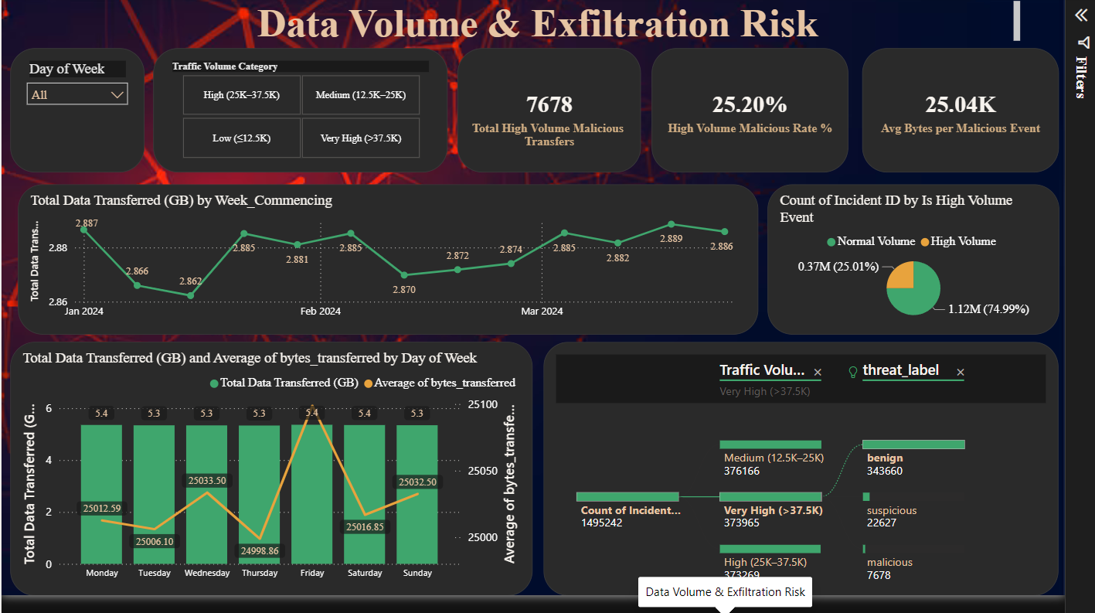
PAGE 6 OF THE POWER BI REPORT: MONITORING ANOMALOUS BANDWIDTH AND EXFILTRATION PATHS
Dashboard — Data Volume & Exfiltration Risk
Key Visuals & Findings
• KPI cards: Total High Volume Malicious Transfers (7,678 events), High Volume Malicious Rate (25.20%), and Average Bytes per Malicious Event (25.04K) establish size parameters of anomalies.
• Weekly Bandwidth Trend: A line chart tracking data volume. Shows steady network bandwidth ranging between 2.86 GB and 2.89 GB per week with minor fluctuations.
• High Volume Donut: Summarizes that exactly 25.01% (0.37M) of connection events are categorized as High Volume transfers, which represent potential exfiltration pipelines.
• Exfiltration Path Visual: Traces connection counts through categories down to threat labels, isolating the 7,678 Very High Volume malicious files that bypassed network controls.

Slide 18
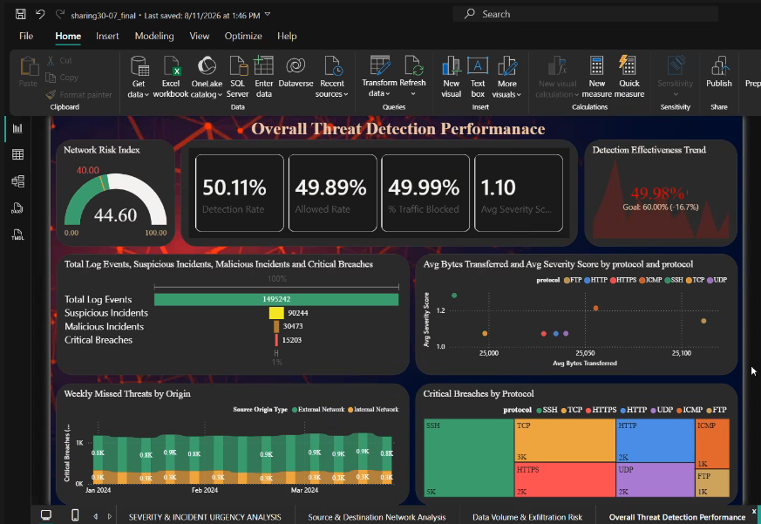
PAGE 7 OF THE POWER BI REPORT: EVALUATING DEFENSE PERFORMANCE, LOGS BREAKDOWN AND VECTOR GAPS
Dashboard — Overall Threat Detection Performance
Key Visuals & Findings
• Network Risk Index: A gauge showing our risk at 44.60, which exceeds our safety target line of 40.00, suggesting elevated network vulnerability.
• Overall Metrics: Reports crucial performance ratios: 50.11% Ingestion/Detection Rate, 49.89% Allowed Rate, and 1.10 Average Severity.
• Detection Effectiveness Trend: Goal-tracking visual showing current performance is 49.98% against our SLA target of 60.00% (-16.7% variance).
• Weekly Missed Threats by Origin: Confirms that allowed malicious events are driven almost entirely by external network vectors, remaining flat over the quarter.
• Critical Breaches by Protocol: Treemap breaks down allowed threats (15K total), identifying SSH (5K) and TCP (3K) as the principal vulnerabilities.

Slide 19
Conclusion
• Cybersecurity systems generate massive amounts of raw data that only becomes useful once it is cleaned and structured.
• Power Query transformed inconsistent, noisy logs into an analysis-ready dataset with built-in risk indicators — Severity_score, Urgency_Flag and Incident_ID.
• With the data connected, cleaned and structured, ThreatLens is now ready to move into data modeling, dashboard design and real-time threat visualization.
Data transforms into real value when it enables teams to make swift, well-informed security choices.
Akshay Jaiswal • Data Visualization Intern • Infosys Springboard

